Slide 1
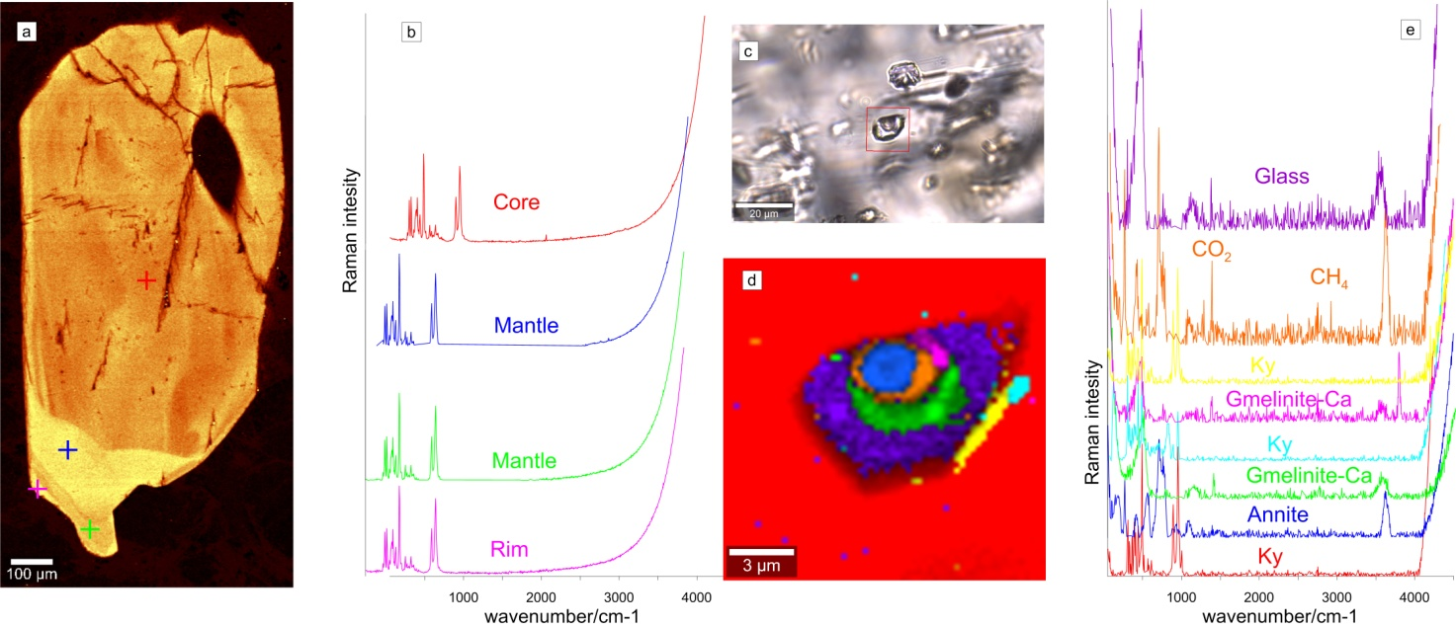
TITLE (suggestions: in 66 pt Bold First Letters in Capital Form)
First Author¹, Second Author², Third Author^{1,2}
(1) Institution, Address, Town, Country, Post code, Presenter (first author): email@address
(2) Institution, Address, Town, Country, Post Code.
Your institutions logo
Aim of the study / Introduction
Aim of the study / Introduction
This template is a suggestion. Let your artistic skills run wild and create a stunning poster that stands out from the rest.
The presenting authors should hang their printed posters in the morning of the first day of the conference and remove them at the end of the conference. The preferable dimensions for posters should be 80 cm x 120 cm (width x height). All posters are required to conform to portrait orientation. Type size should be sufficiently large to allow people to read from a distance of about 2 metres. As a thumb rule, the text should be readable if the poster is printed out on an A4 sheet (e.g. Arial >24 points).
Methods
This template is a suggestion. General Instructions.
The presentation must cover the same material as the abstract. Do not include an abstract on a poster!
General guidelines:
- Artistic design is not a substitute for content.
- Think about the rough layout of your poster in advance. Put the title at the beginning. Start at the top with the aim of the study/introduction and finish at the bottom with the concluding remarks, with methods and results filling the centre section.
- Use short sentences, simple words and bullet points to illustrate your points.
- The text should be broken up by graphics or photos.
- Self-explanatory graphics should dominate the poster. The success of a poster is directly related to the clarity of your illustrations and tables!
- Avoid the use of jargon, acronyms or unusual abbreviations.
Results
This template is a suggestion. General Instructions.
- Target: 20% text, 40% graphics, 40% space.
- Make sure that ideas flow logically from one section to the next.
- Use charts and graphs to illustrate data (avoid large tables of raw data).
- Use high-resolution photos.
- Do not use all capital letters.
Figure X:
Concluding Remarks
Acknowledgments/Further information/References
A poster is a multi-layered communication method.
A poster should disclose key messages at first sight
16th International GeoRAMAN Conference, 24-27 September 2024, Rhodes, Greece

